Slide 1
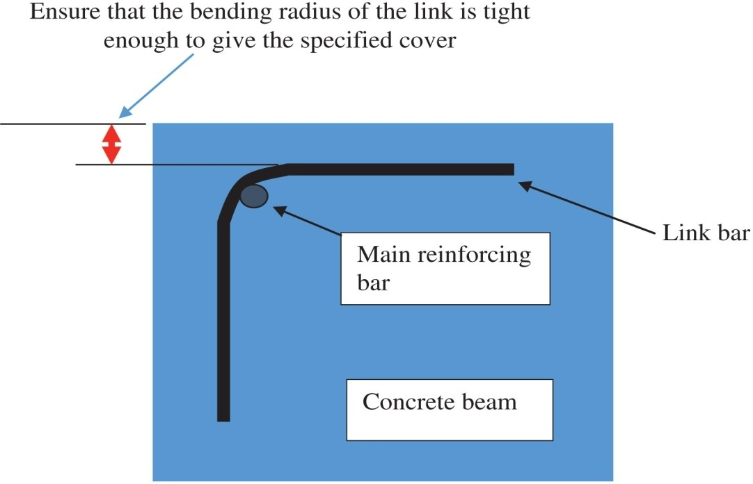
FIGURE 26.1 Schematic Diagram Showing Cover Measurement
Copyright © 2016 Elsevier Ltd. All rights reserved.

Slide 2
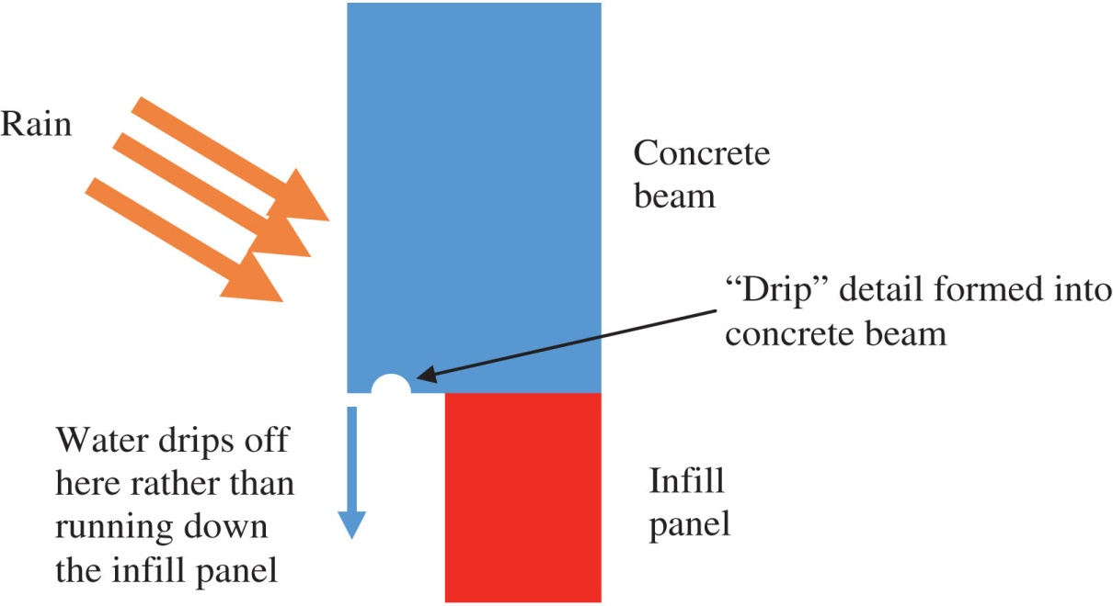
FIGURE 26.2 Design Detail to Shed Water
Copyright © 2016 Elsevier Ltd. All rights reserved.

Slide 3
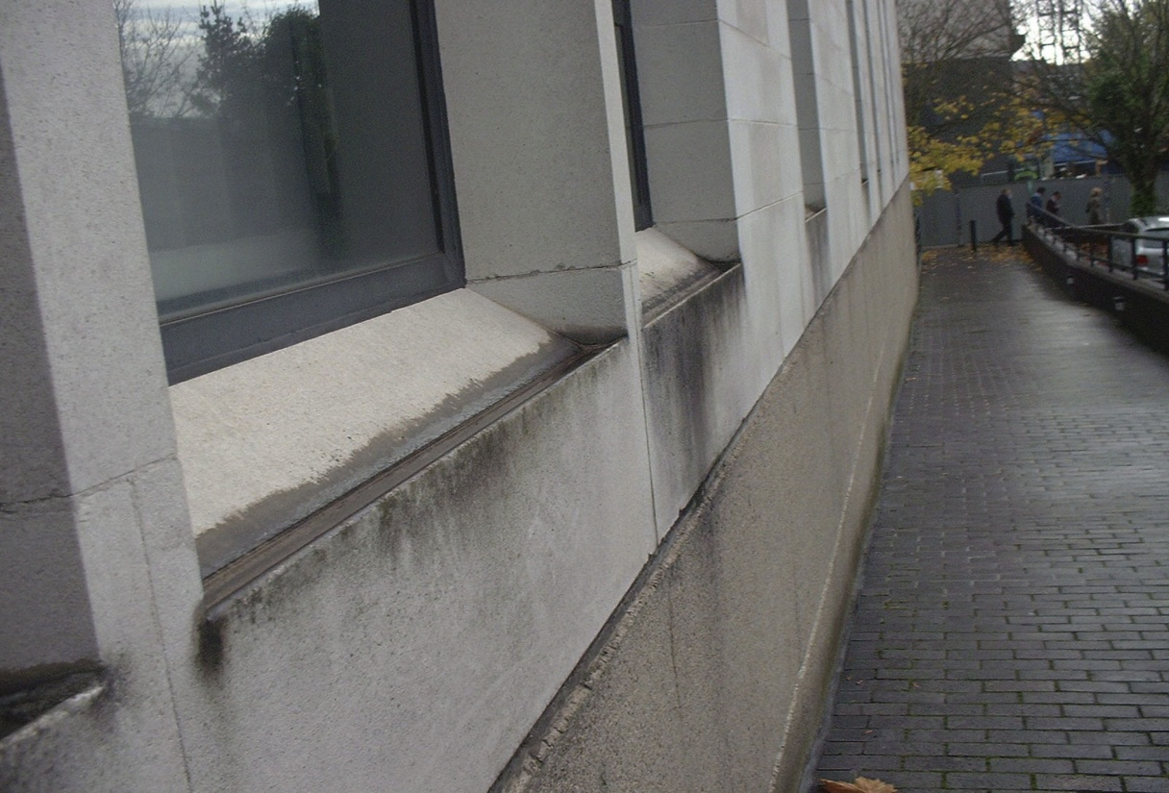
FIGURE 26.3 Poor Detail of Precast Sill That Does not Shed Water
Copyright © 2016 Elsevier Ltd. All rights reserved.

Slide 4
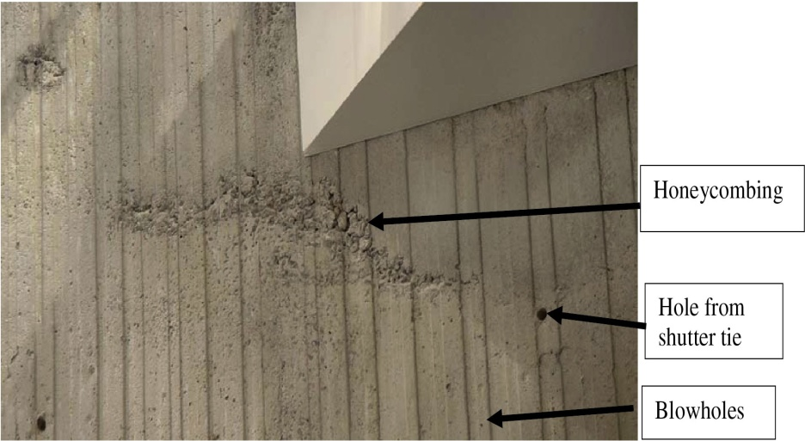
FIGURE 26.4 Defects in Concrete Surface
Copyright © 2016 Elsevier Ltd. All rights reserved.

Slide 5
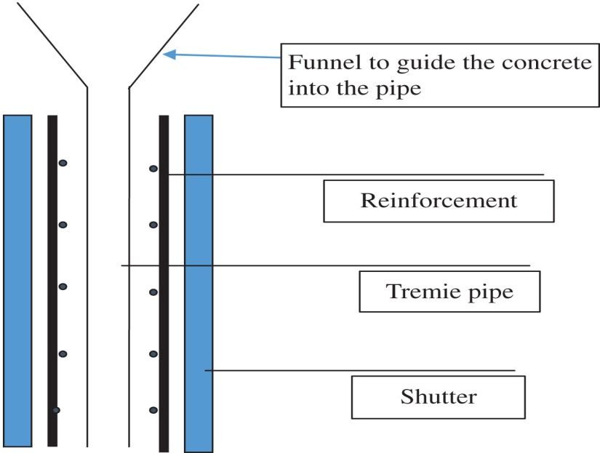
FIGURE 26.5 Use of Tremie Pipe
Copyright © 2016 Elsevier Ltd. All rights reserved.

Slide 6
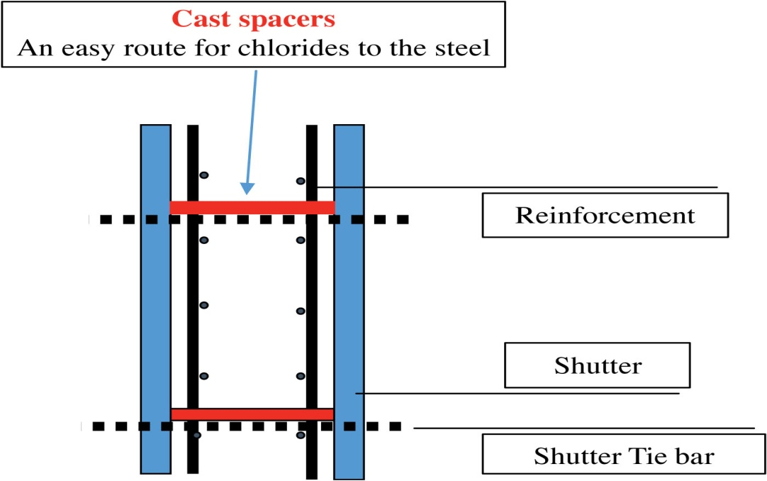
FIGURE 26.5 Use of Tremie Pipe
Copyright © 2016 Elsevier Ltd. All rights reserved.

Slide 7
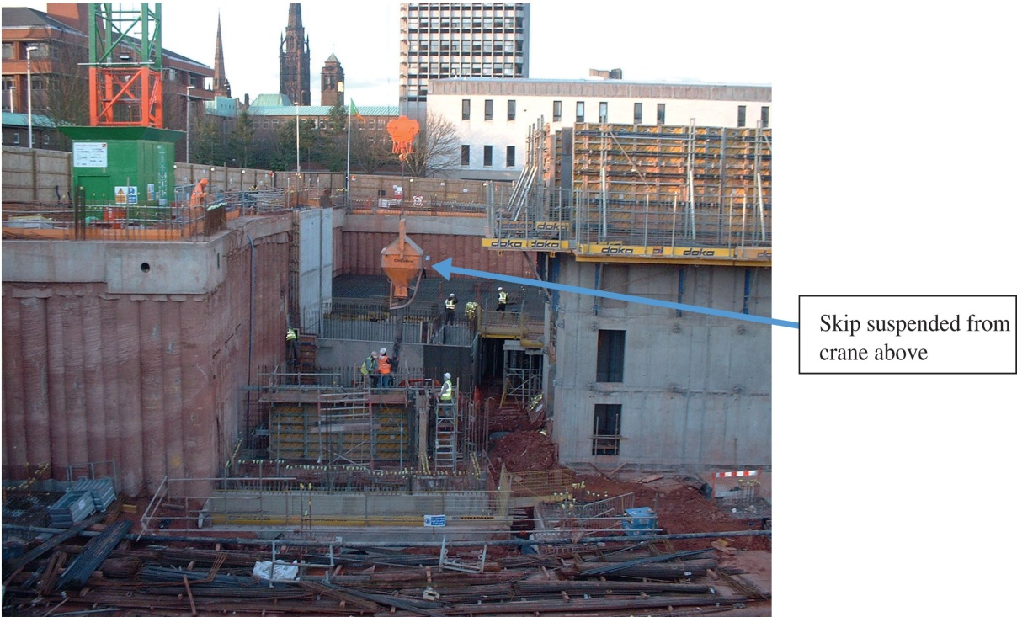
FIGURE 26.7 Concrete Placement From a Skip for a Below Ground Parking Garage
Copyright © 2016 Elsevier Ltd. All rights reserved.

Slide 8
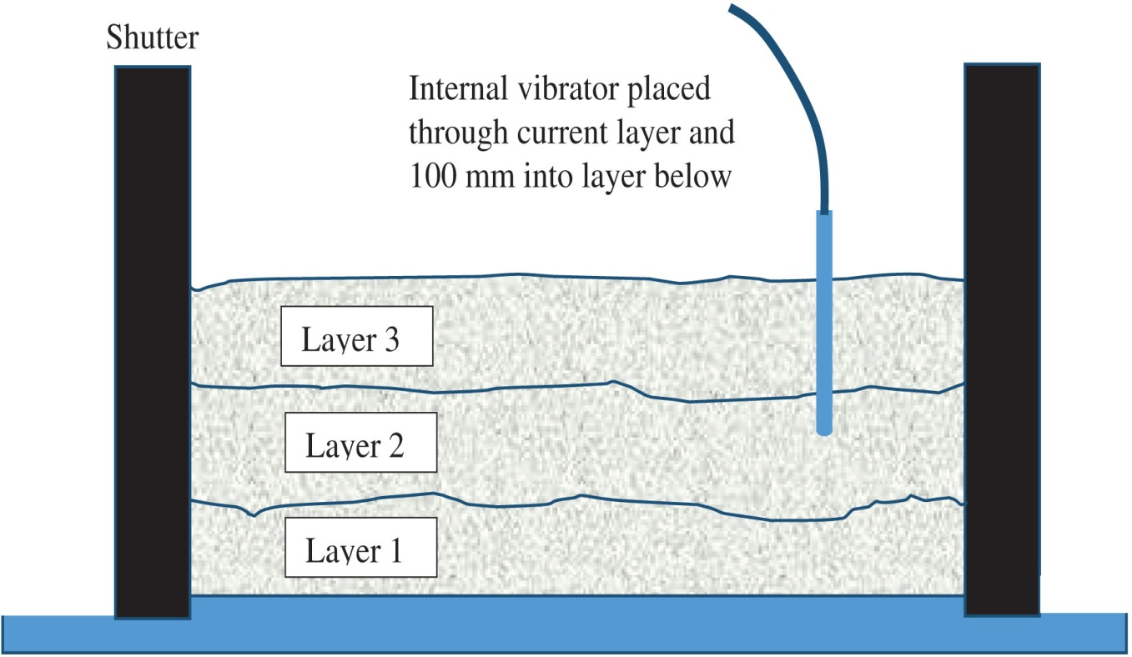
FIGURE 26.8 Sequence of Vibration
Copyright © 2016 Elsevier Ltd. All rights reserved.

Slide 9
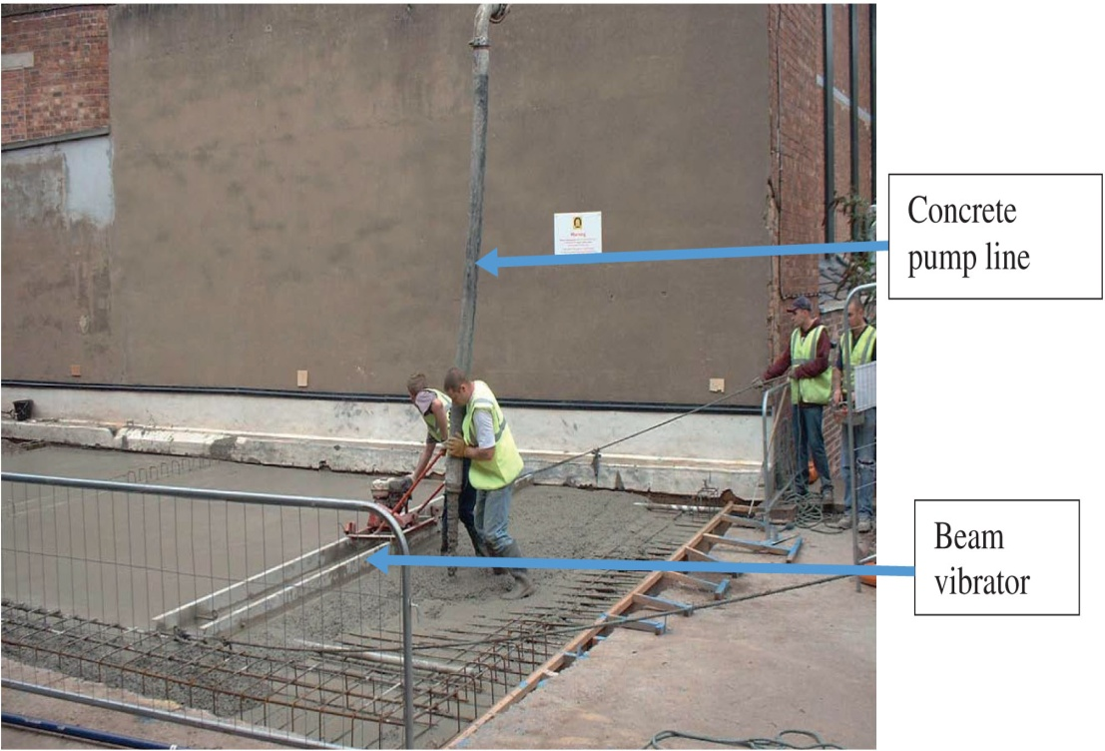
FIGURE 26.9 Placing Concrete Slab
Copyright © 2016 Elsevier Ltd. All rights reserved.

